Slide 1

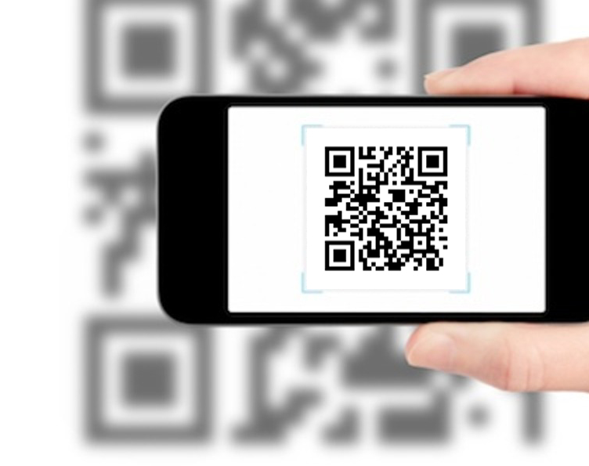
QR Code Generator

Slide 2
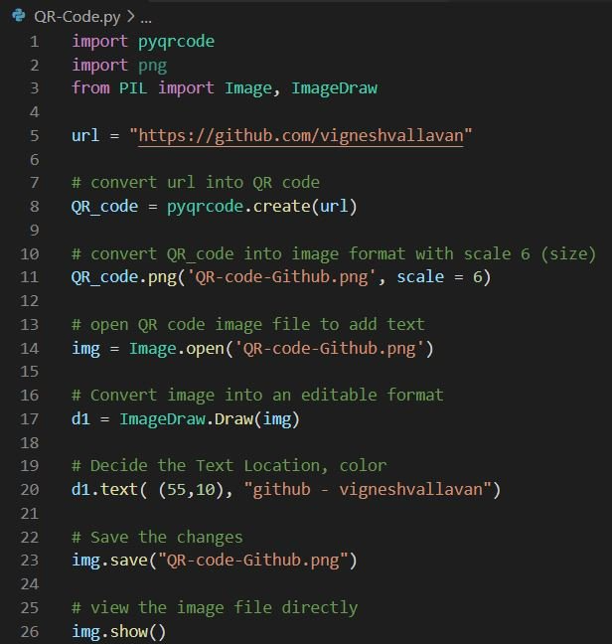
Python Snippet
Install pyqrcode in Python <pip install pyqrcode>
--> For generating QR code
2. Install png in Python <pip install pypng>
--> For creating an image file as PNG format
3. Install pillow (PIL) in Python <pip install pillow>
--> For Adding text into an image file
Steps:
Generate QR code based on URL of GitHub account
Convert it into PNG file
Open PNG file for edit
Convert PNG file into Editable format
Add text into the PNG file
Save the file

Slide 3

Output: Image file (PNG)

